Slide 1
Developing and deploying AI solutions on the cloud using Team Data Science Process (TDSP) and Azure Machine Learning (AML)
1
Debraj GuhaThakurta
Microsoft, AI & Research
Cloud AI Platform
Algorithms and Data Science Group
Global Artificial Intelligence Conference January 18, 2018, Santa Clara, CA
Deck available @: https://aka.ms/tdsp-presentations

Slide 2
Agenda
2
Process
Tools (algos, IDEs, workbench)
Platform (compute, storage, ...)
Team Data Science Process (TDSP)
Principle and objective
Key components
Adoption and use
Azure Machine Learning (AML)
Key features
Developing and deploying AI solutions
Using TDSP with AML (process + tools)
Summary
Process, tools and platforms for AI solutions

Slide 3




Team Data Science Process (TDSP) Agile and iterative process to develop, deploy and manage AI applications in the cloud
3
Business Understanding
Data acquisition & understanding
Modeling
(ML/AI)
Deployment
https://aka.ms/tdsp
tdsp-feedback@microsoft.com

Slide 4
The opportunity and challenge of data science in enterprises
4
Opportunity: 17% had a well-developed Predictive/Prescriptive Analytics program in place, while 80% planned on implementing such a program within five years – Dataversity 2015 Survey
Challenge: Only 27% of the big data projects are regarded as successful – CapGenimi 2014
Tools & data platforms have matured -
Still a major gap in executing on the potential

Slide 5
One reason: Process challenge in Data Science
5
Global Teams
Organization
Collaboration
Quality
Knowledge Accumulation
Agility
Geographic Locations
Team Growth
“Intelligent” application (ML/AI) development has unique complexity not always encountered in other Software Development scenarios
Onboard New Members Rapidly
Varied Use Cases
Industries and Use Cases
Diverse DS Backgrounds
DS have diverse backgrounds, experiences with tools, languages

Slide 6
Why is a process useful for Data Science?
6
A process is a detailed sequence of activities necessary to perform specific business tasks
It is used to standardize procedures and establish best practices
Technology and tools are changing rapidly. A standardized process can provide continuity and stability of work-flow.
- Based on discussions with Luis Morinigo, Dir. IoT, NewSignature

Slide 7
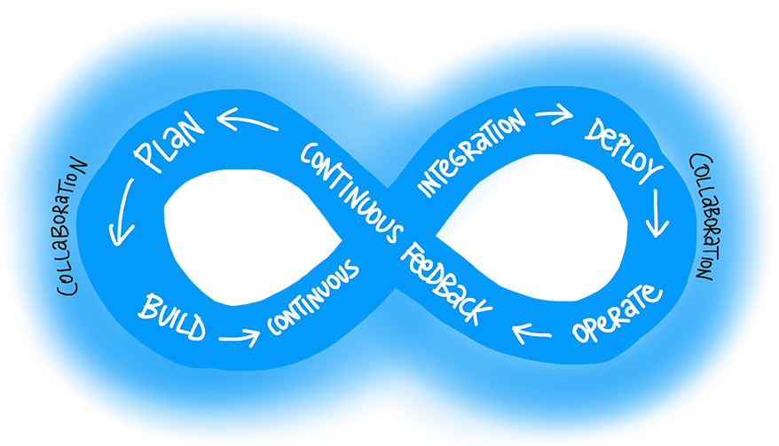
Data Science can borrow processes from DevOps
7
Integrated Software Development & Operations (DevOps) has had much more time to mature, standardize, build in efficiency and develop best practices
Data Science has unique complexity – but can learn standardized processes from DevOps

Slide 8
TDSP objective
8
Integrate DevOps with data science workflows to improve collaboration, quality, robustness and efficiency in data science projects
DevOps
+
Data Science
=
TDSP
Infrastructure as Code (IaC)
Build
Test
CI / CD
Release management
Performance monitoring
Data ingestion
Data exploration
Modeling (experimentation)
Model deployment & consumption
Agile

Slide 9
TDSP features for data science teams
9
Standardized Data Science Lifecycle
Infrastructure & Toolkits
Project Structure, Templates & Roles
Project Execution (incl. DevOps components)
Re-usable Data Science Utilities

Slide 10
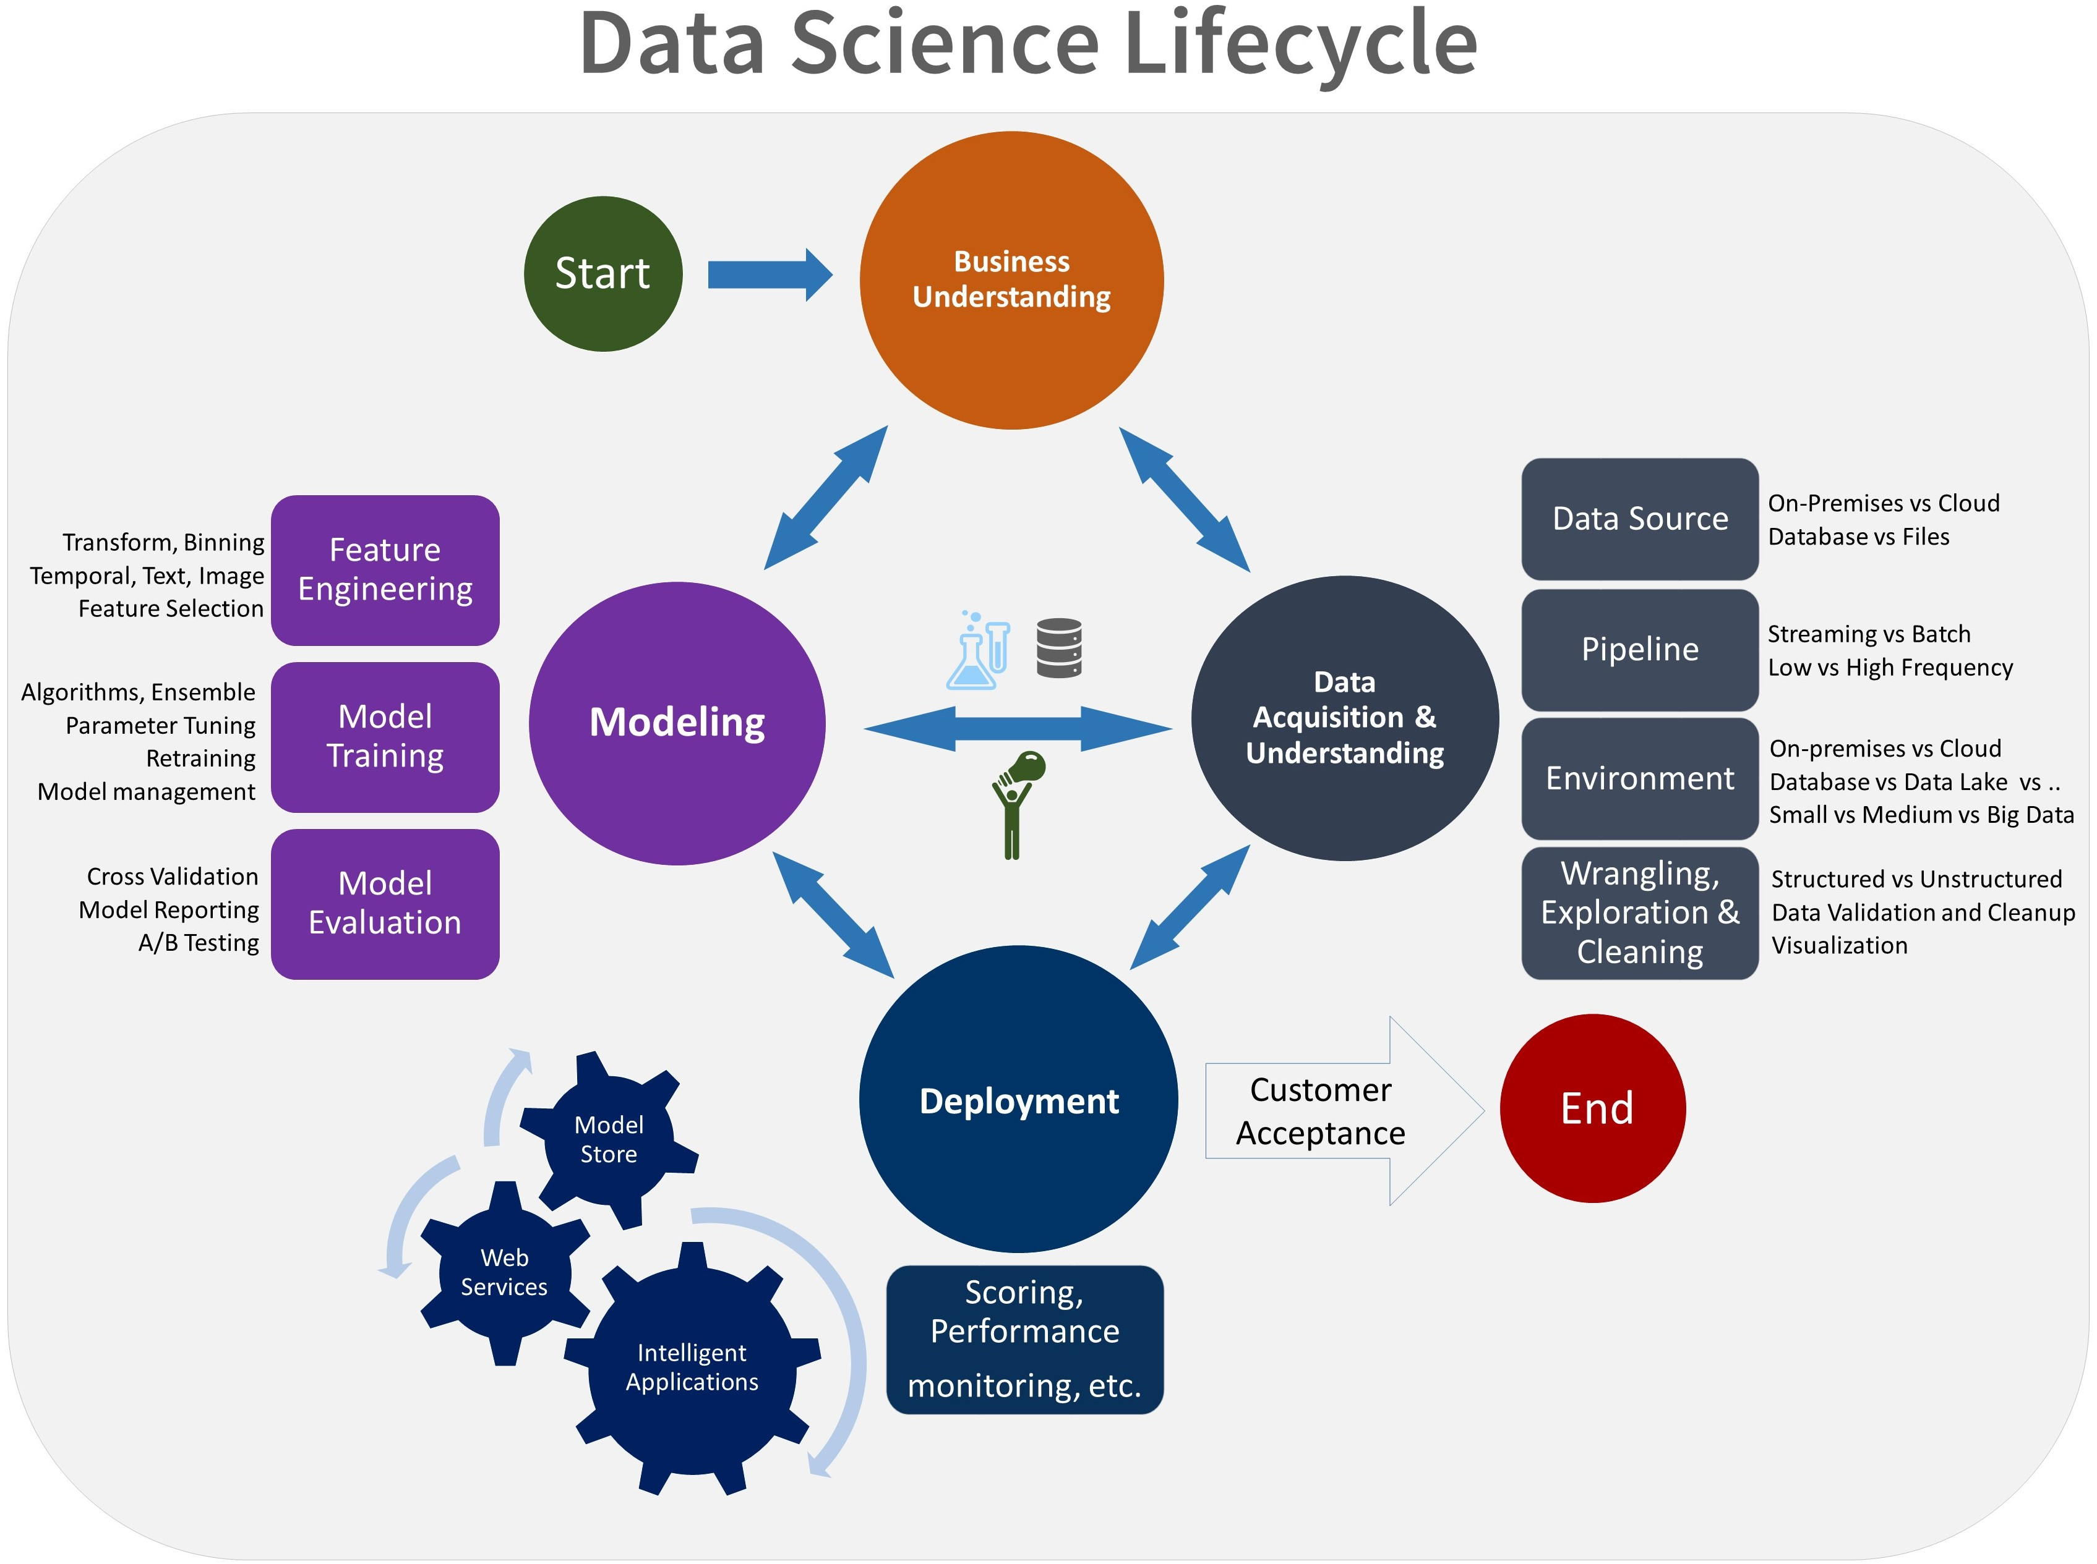
Data Science lifecycle
10
Lifecycle
Primary stages:
Business Understanding
Data Acquisition and Understanding
Modeling
Deployment

Slide 11
TDSP lifecycle stages can be integrated with specific deliverables & checkpoints
11
Lifecycle
Business Understanding
Project Objective
Data acquisition and understanding
Data Quality Report
Deployment
Predictive Model
Modeling
Featurization
Modeling Report
Source code repo
Final deployment platform & architecture
Data, Target & Feature Definition
Data Dictionary
Architecture Diagram (initial draft)
Final model reporting

Slide 12
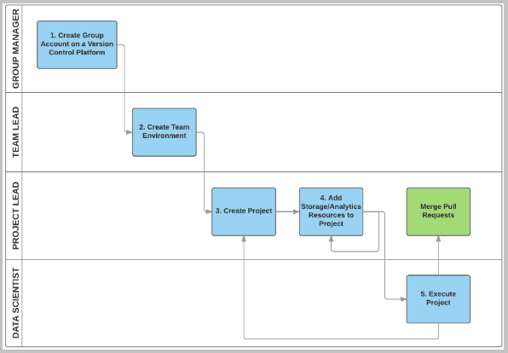
Project roles & tasks Personas: account managers, PMs, DSs, SWEs, architects
12
Structure, templates, roles
Governance and Project Management
Team lead
Git template repo & sever management, access control
Project lead
Business understanding, create project, work-items
AI Developers
Data scientist
Modeling, exploratory analysis
SWE, data engineers, or architect
Data ingestion, deployment, solution architecture, integration into business applications
NOTE: Specific roles depend on organizations

Slide 13
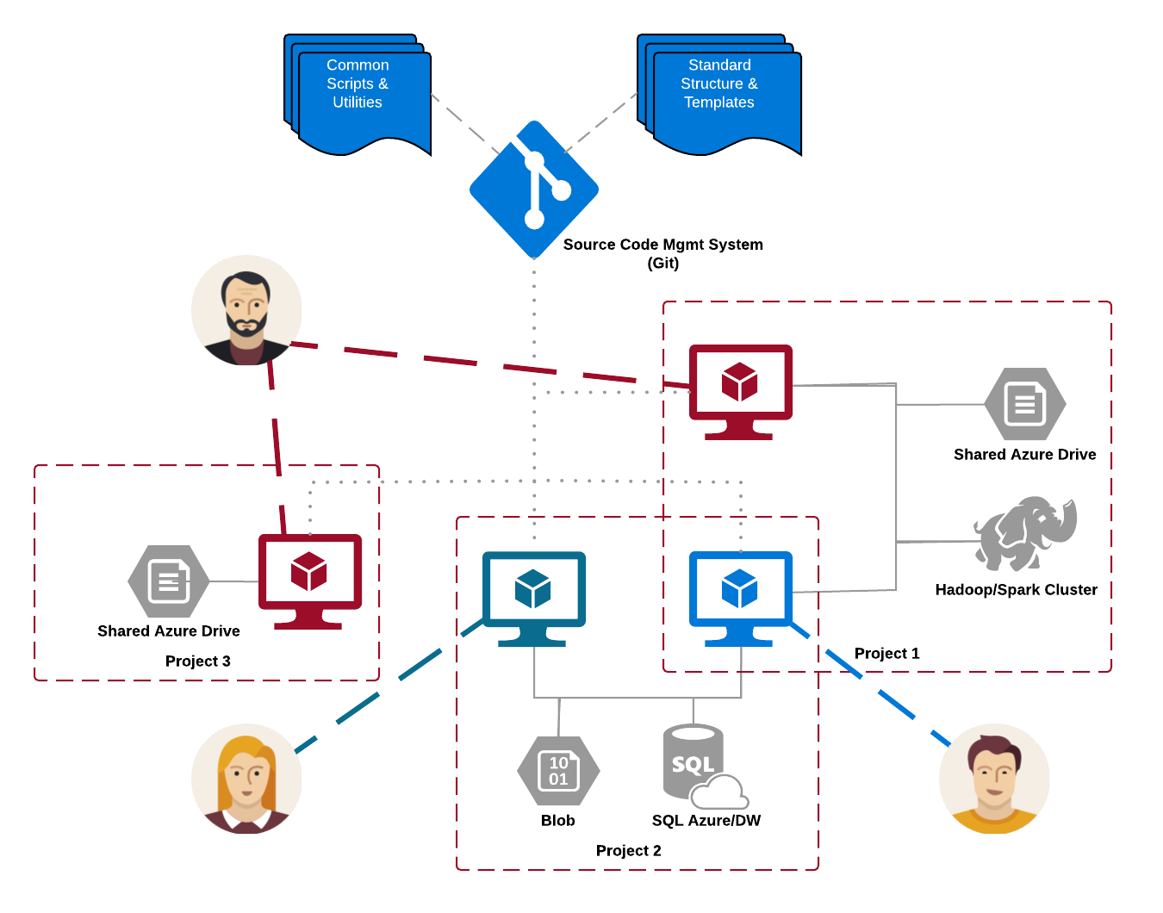
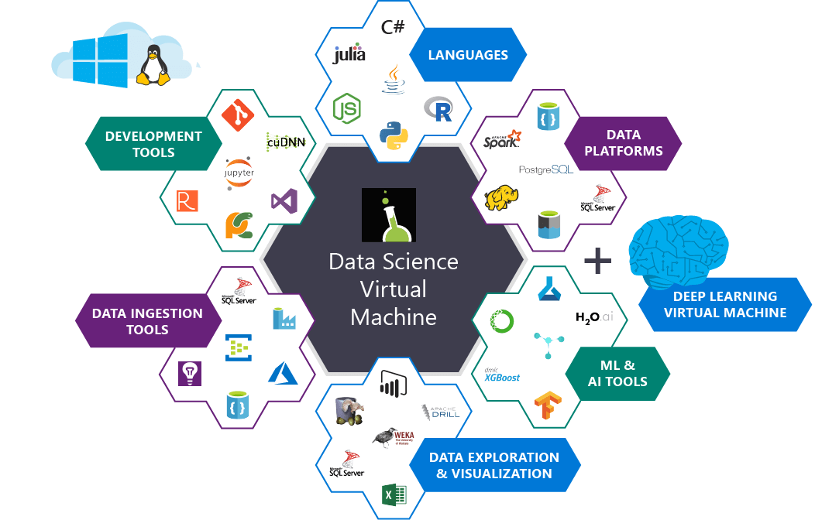
Shared and distributed infrastructure & toolkits
13
Project artifacts & code stored in central git (version control) repositories.
Data typically stored in cloud stores, such as blob or database
Virtual machines (VMs), or clusters are disposable compute, added to projects as needed
Many-to-many relationship between data scientists, compute and projects
Infrastructure & toolkits

Slide 14
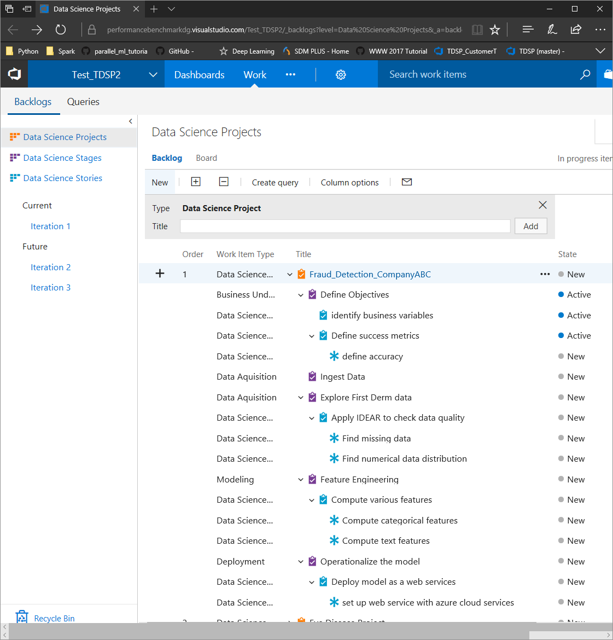
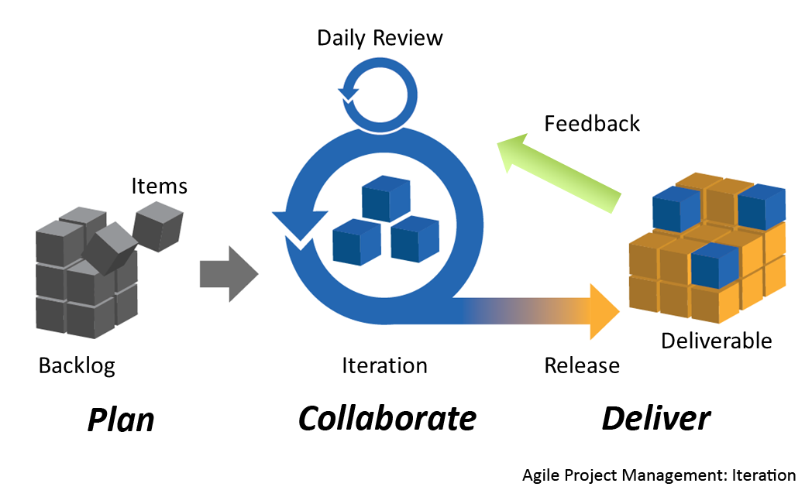

Agile work planning and execution template
14
Use Agile work planning & execution template (data science specific)
DS Projects: e.g. “Fraud Detection for Customer ABC”
DS Stages: correspond to the stages in TDSP lifecycle.
DS Stories: correspond to the life-cycle sub-stages.
DS Tasks: Tasks are assignable code or document work items to complete a specific data science story.
Project execution guidelines
Scrum
framework
https://commons.wikimedia.org

Slide 15
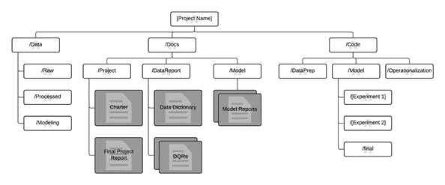
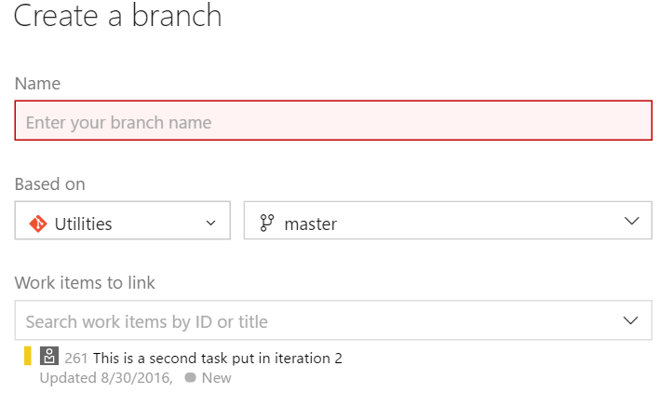

Collaborative development guidelines
15
Version control and review
Git is a Version Control System
Each repo contains the full change history
Used in a distributed way with a single remote repo and several local repos (on local machine or a VM)
TDSP git Template
Project execution guidelines
Remote
Integrated Agile planning & code development
Local
Local
Local
Local

Slide 16
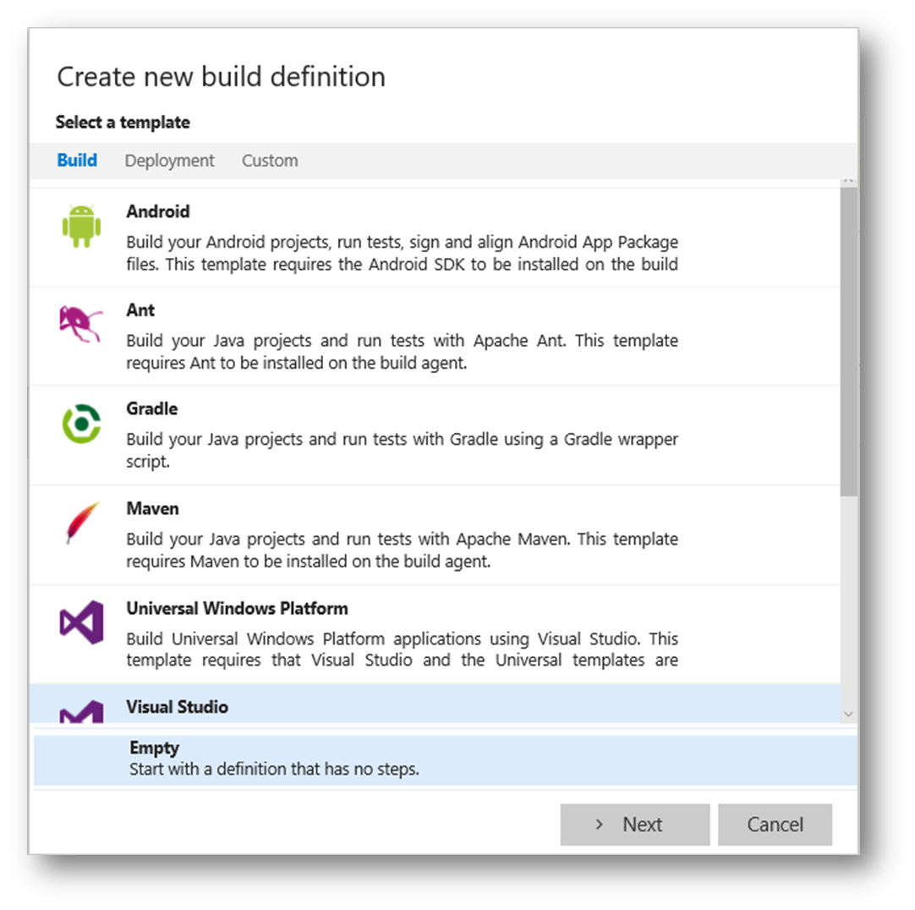
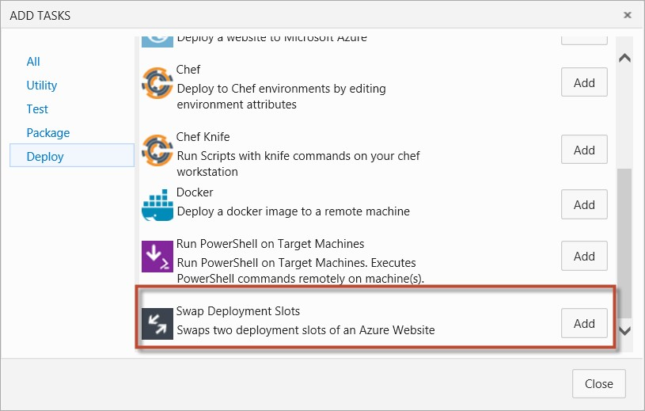
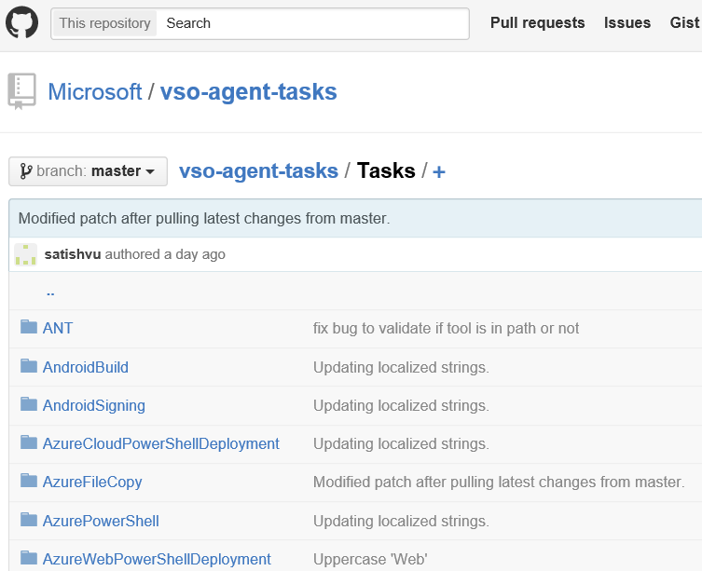
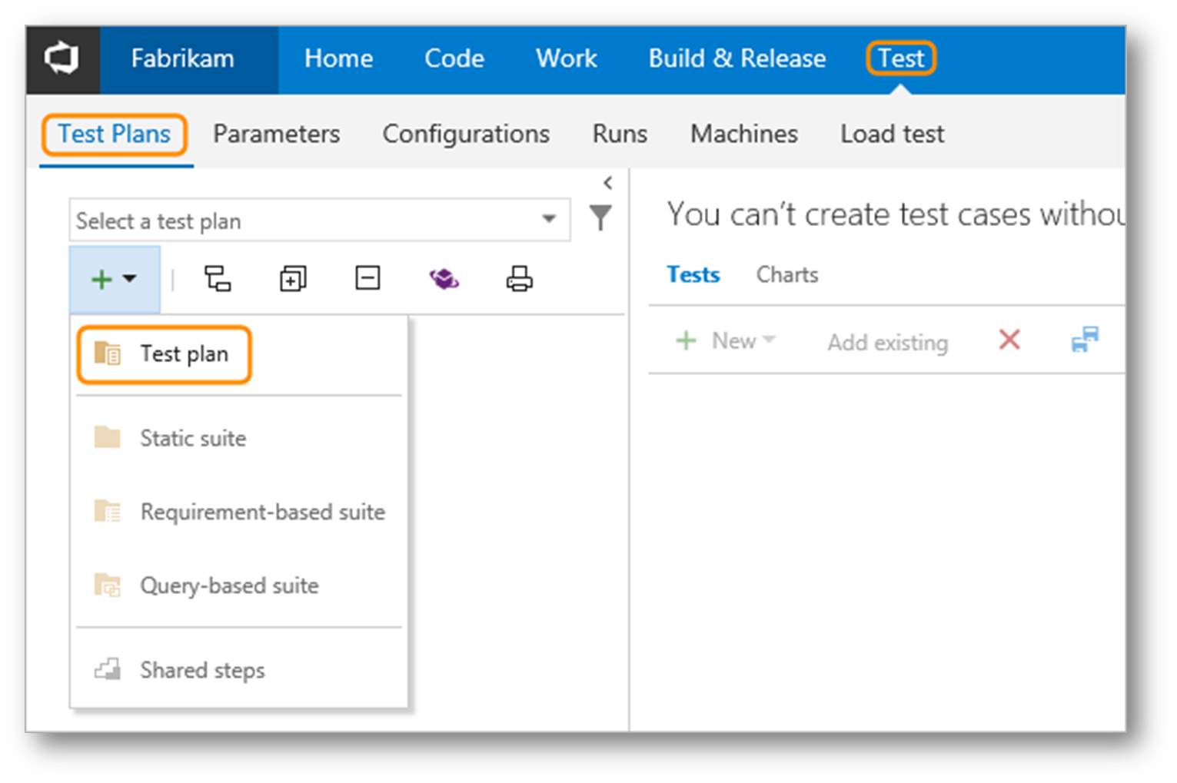
Custom Build Tasks
16
Integrating DevOps in projects
Project execution guidelines
Notes:
Understanding TFS/VSO builds - https://msdn.microsoft.com/en-us/library/ms181709(v=vs.90).aspx

Slide 17
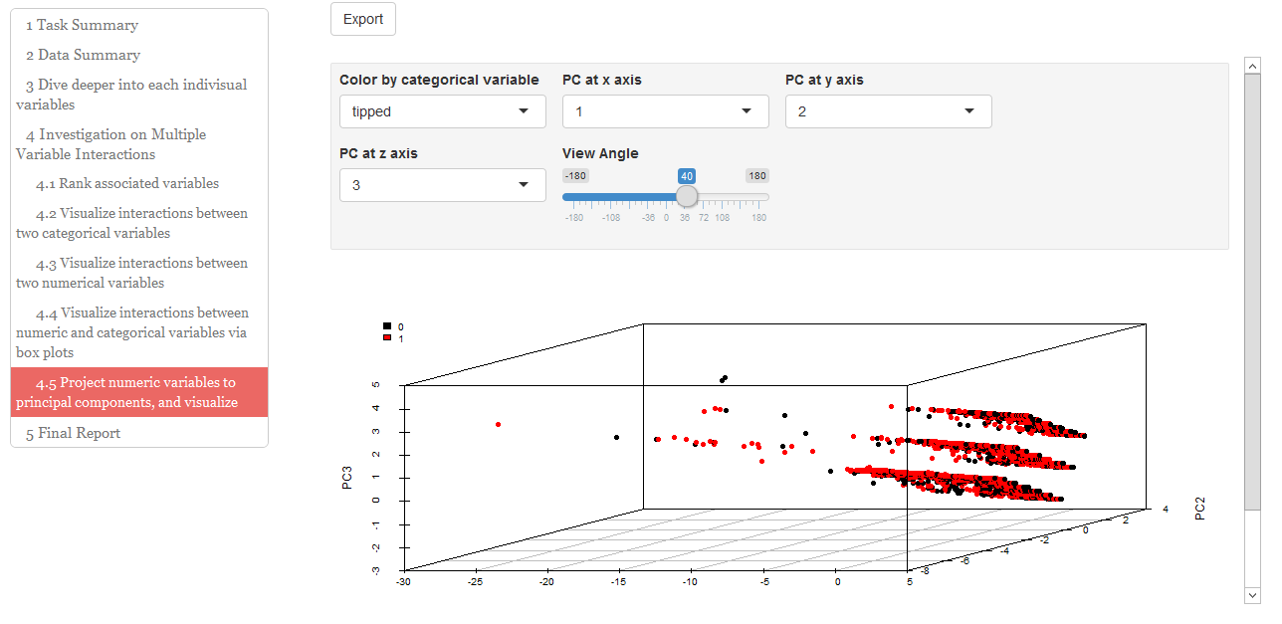
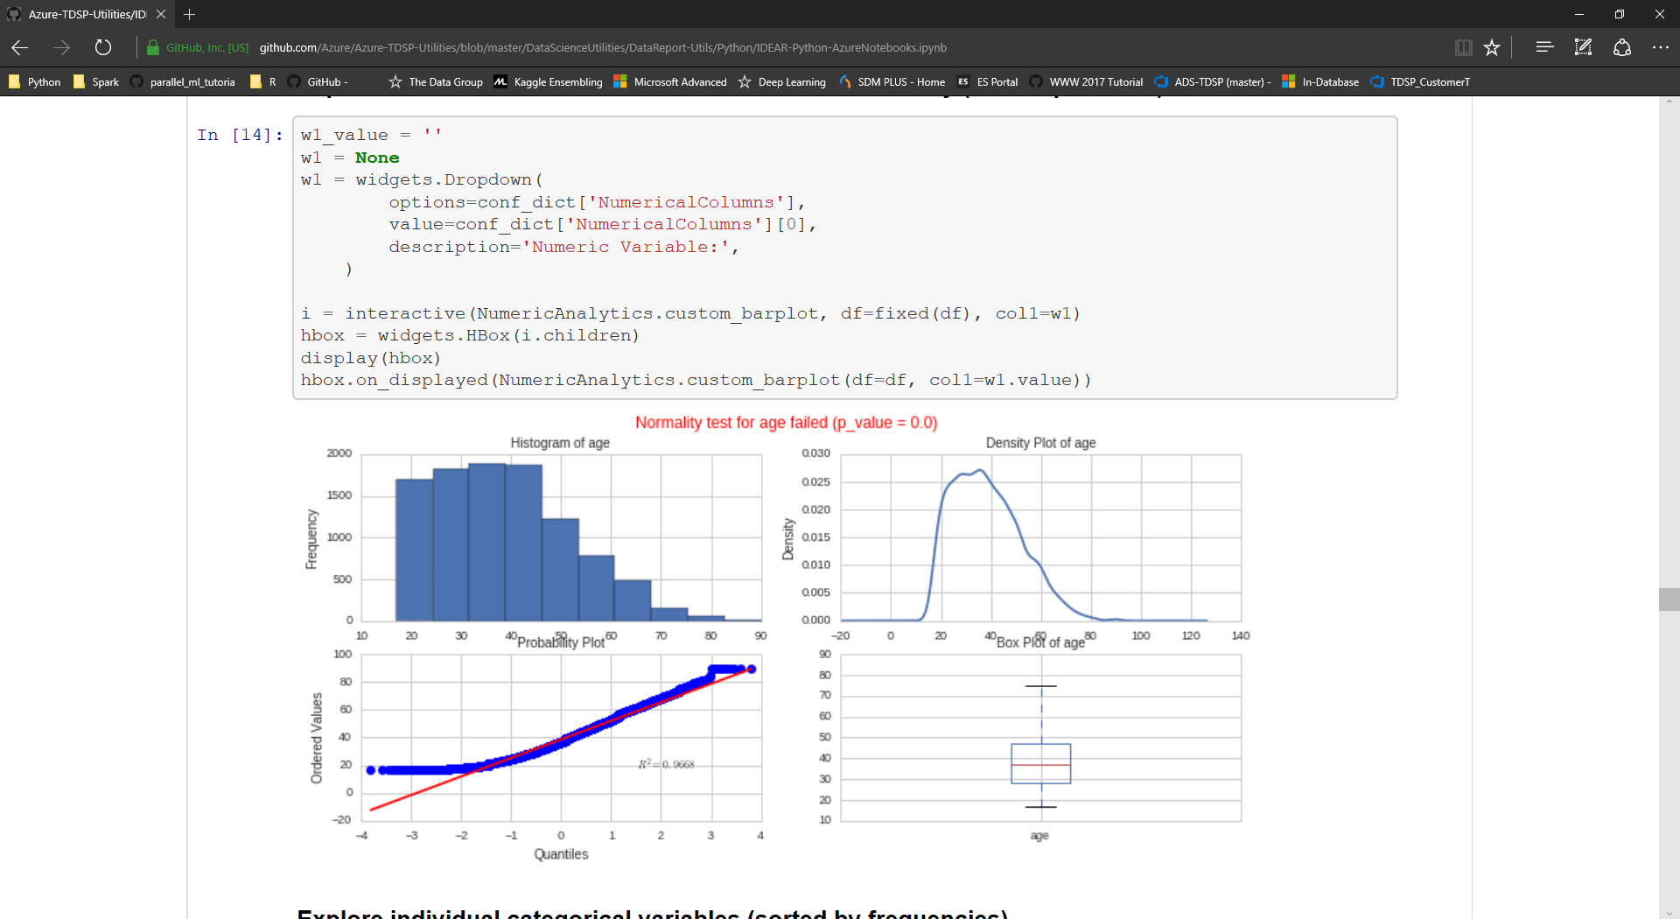
Re-usable data science utilities: Analytics Interactive data exploration and reporting – IDEAR (Python, R, MRS)
17
DS utilities
Data quality assessment
Getting business insights from the data
Association between variables
Generating standardized data quality reports automatically
Clustering
Distribution assessment
https://github.com/Azure/Azure-TDSP-Utilities

Slide 18
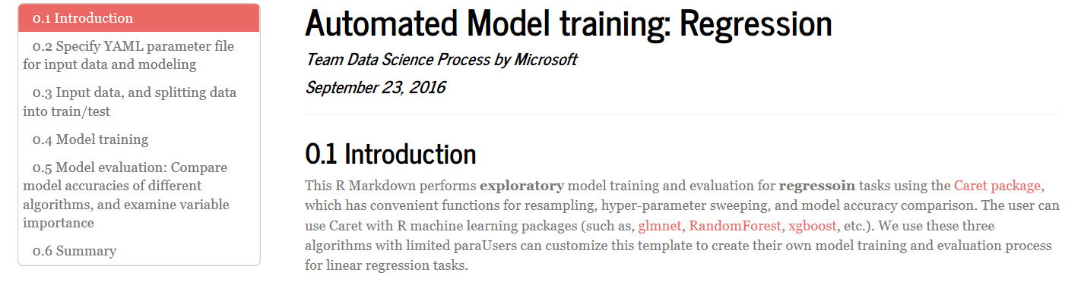
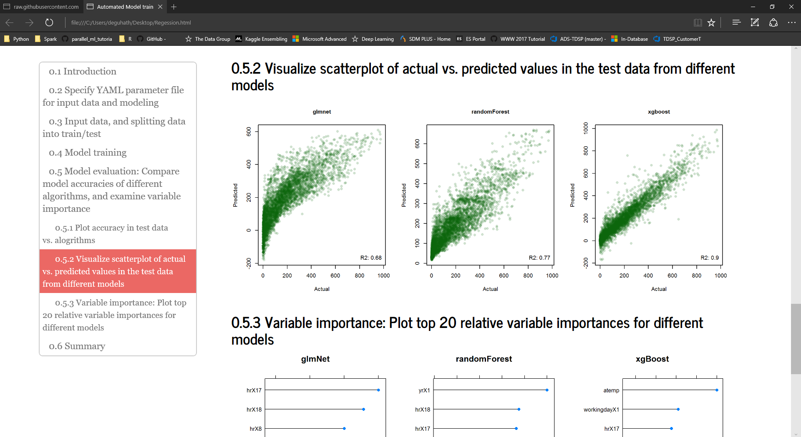
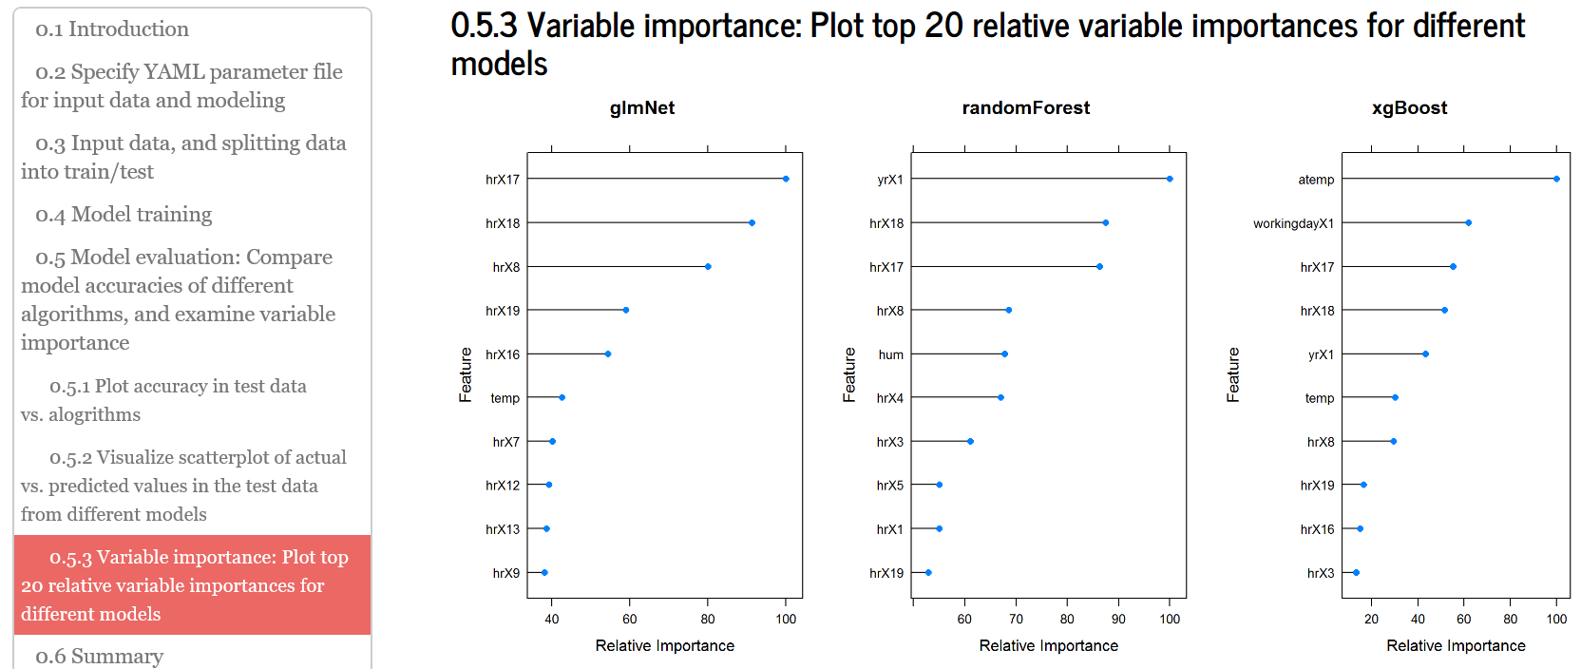
Re-usable data science utilities: Analytics - modeling Automated modeling and reporting AMAR (R)
18
DS utilities
Predicted vs. Actual (multiple algorithms)
Feature Importance (multiple algorithms)
https://github.com/Azure/Azure-TDSP-Utilities

Slide 19
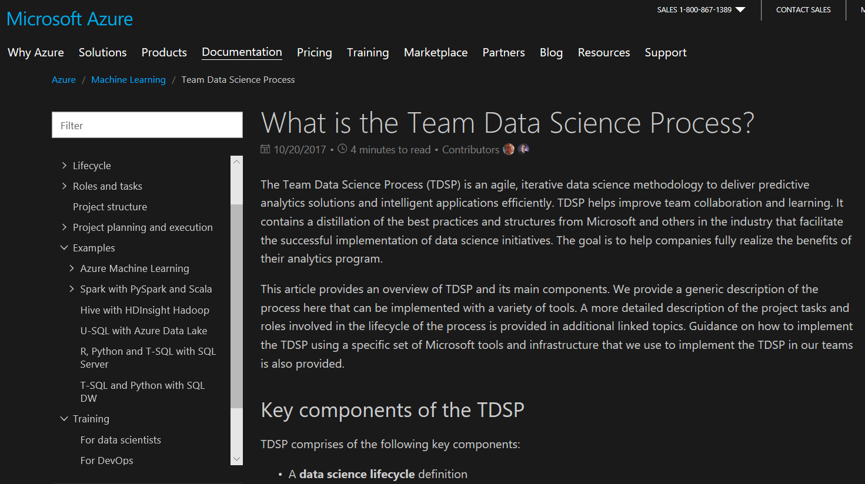
TDSP documentation: https://aka.ms/tdsp
19

Slide 20
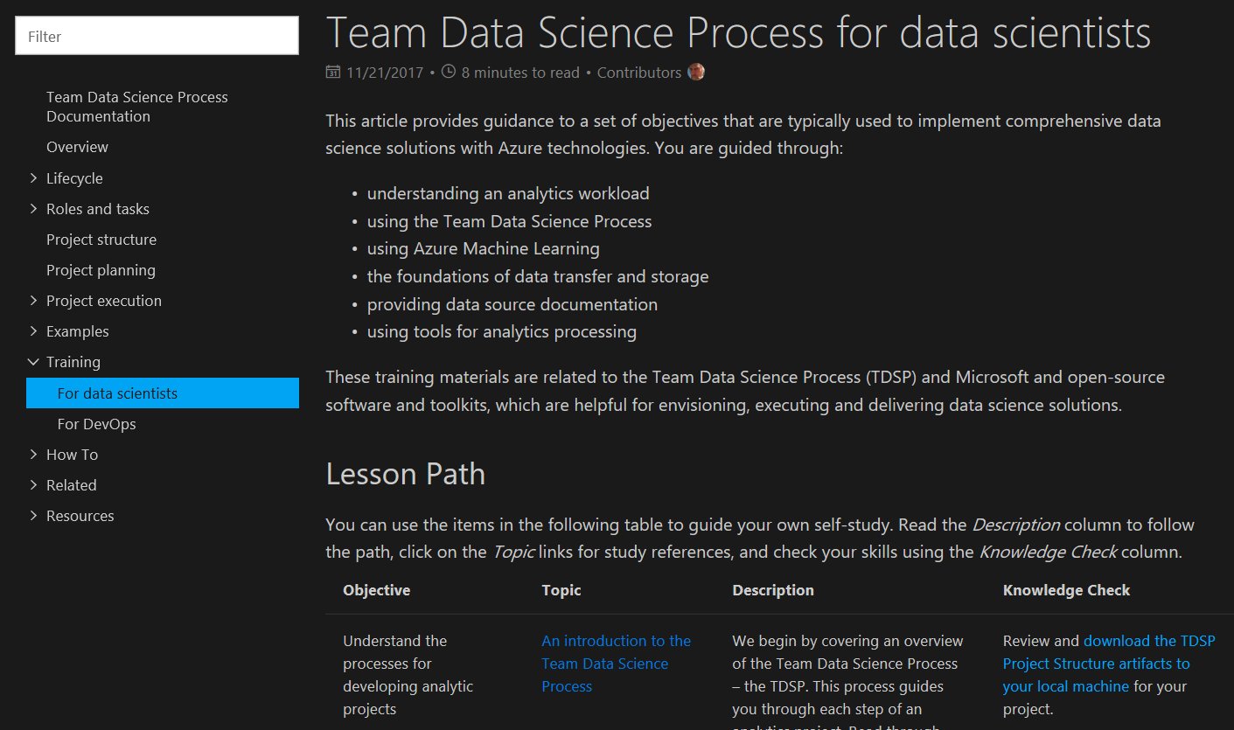
TDSP trainings
20

Slide 21
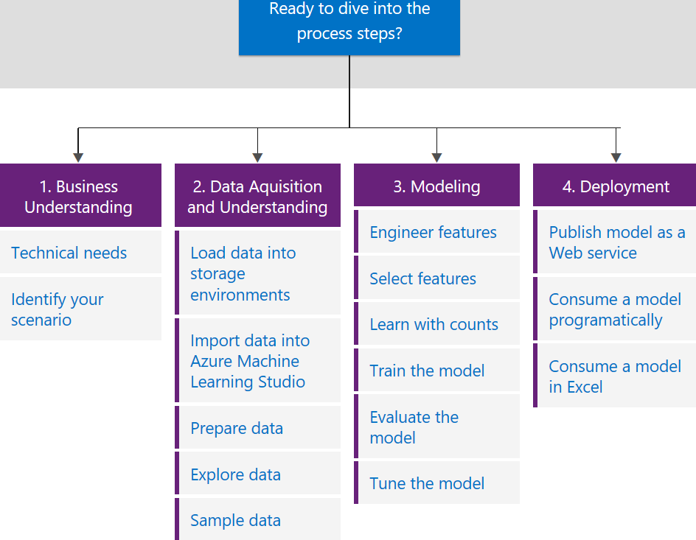
TDSP in action: E2E worked-out samples
21
Azure Machine Learning
Azure HDInsight Spark
Azure HDInsight Hadoop
SQL-server with R and Python
Azure SQL data warehouse
Azure Data Lake

Slide 22
Adoption: How to stage (if needed)
22
Data science teams may stage adoption as follows
Level 1
- One git repository per project
Leve 3
- Develop process to graduate code from projects to the shared team utility repo
Level 4
- Link git branch with work items
Level 2
- Customize templates to fit team needs
- Create shared team utility repo (like IDEAR, AMAR)
- Standard directory structure
- Standardized templates like charter, exit reports
- Planning and tracking of work items
- Develop E2E worked-out templates
- Use mature work planning and tracking system (e.g. Agile)
- Code review
- Manage and version model and data assets
- Develop automated testing framework
- Develop automated CI/CD

Slide 23



Adoption: Customers
23
External partners
New Signature
BlueGranite
Microsoft internal
Microsoft consulting services (MCS)
AI & R Cloud Platform: Algorithm and data sciences team
Windows Devices DS team
…
…

Slide 24
Using TDSP with AML
24

Slide 25
25
Azure Machine Learning
LOB
CRM
INGEST
STORE
PREP & TRAIN
MODEL & SERVE
Graph
On-prem
Cloud
Image
Data orchestration and monitoring
Data lake and storage
Hadoop/Spark/SQL and ML
Social
IoT
Apps + insights
IoT
Cloud
Azure Machine Learning

Slide 26
Deploy everywhere
26
Single node deployment (cloud/on-prem)
Azure Container Service
Azure IoT Edge
DOCKER
Spark clusters
Notes:
Docker container based deployment allows:
Single node deployment (cloud/on prem)
Clustered deployments via Azure Container Service
public preview target of 10k RPS on ACS cluster configuration
Currently have published models (via TLC) with <10ms latency
Edge deployment via Azure IOT Edge
Microsoft ML Server on-premises
Other deployment options
Spark clusters
Data engines:
SQL
CosmosDB (roadmap)
U-SQL (roadmap)
FPGAs (roadmap)
Serverless (roadmap)
Docker logo
Single node (on prem, cloud
ACS
Edge
MSFT ML Services
Spark cluster
SQL
Use slide 8 as reference
List

Slide 27

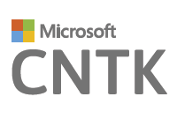
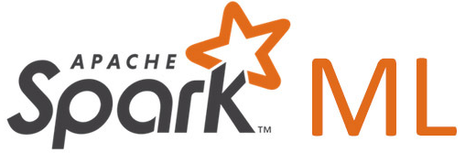

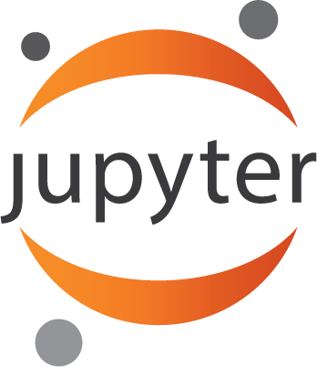
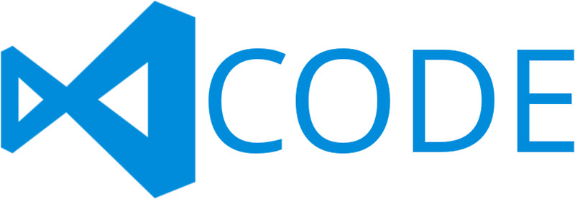


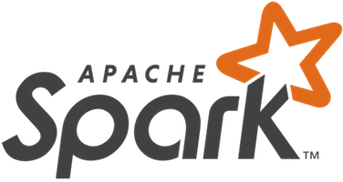
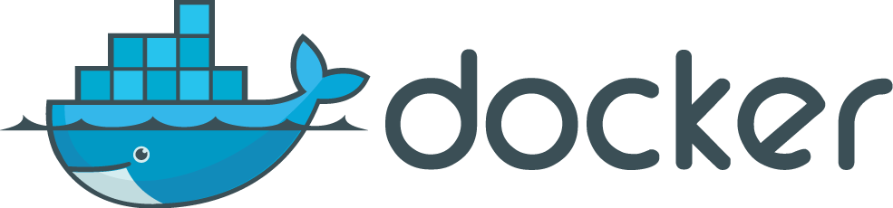
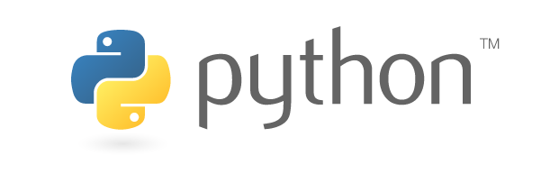
Use what you want
27
Use any framework or library
Use your favorite IDE
Leverage all types of platforms and tools/libraries
Use any tool
Use the most popular innovations
Notes:
Any data, any framework. Tensorflow logo, CNTK logo, Spark logo
See inset for Tensorflow logo

Slide 28
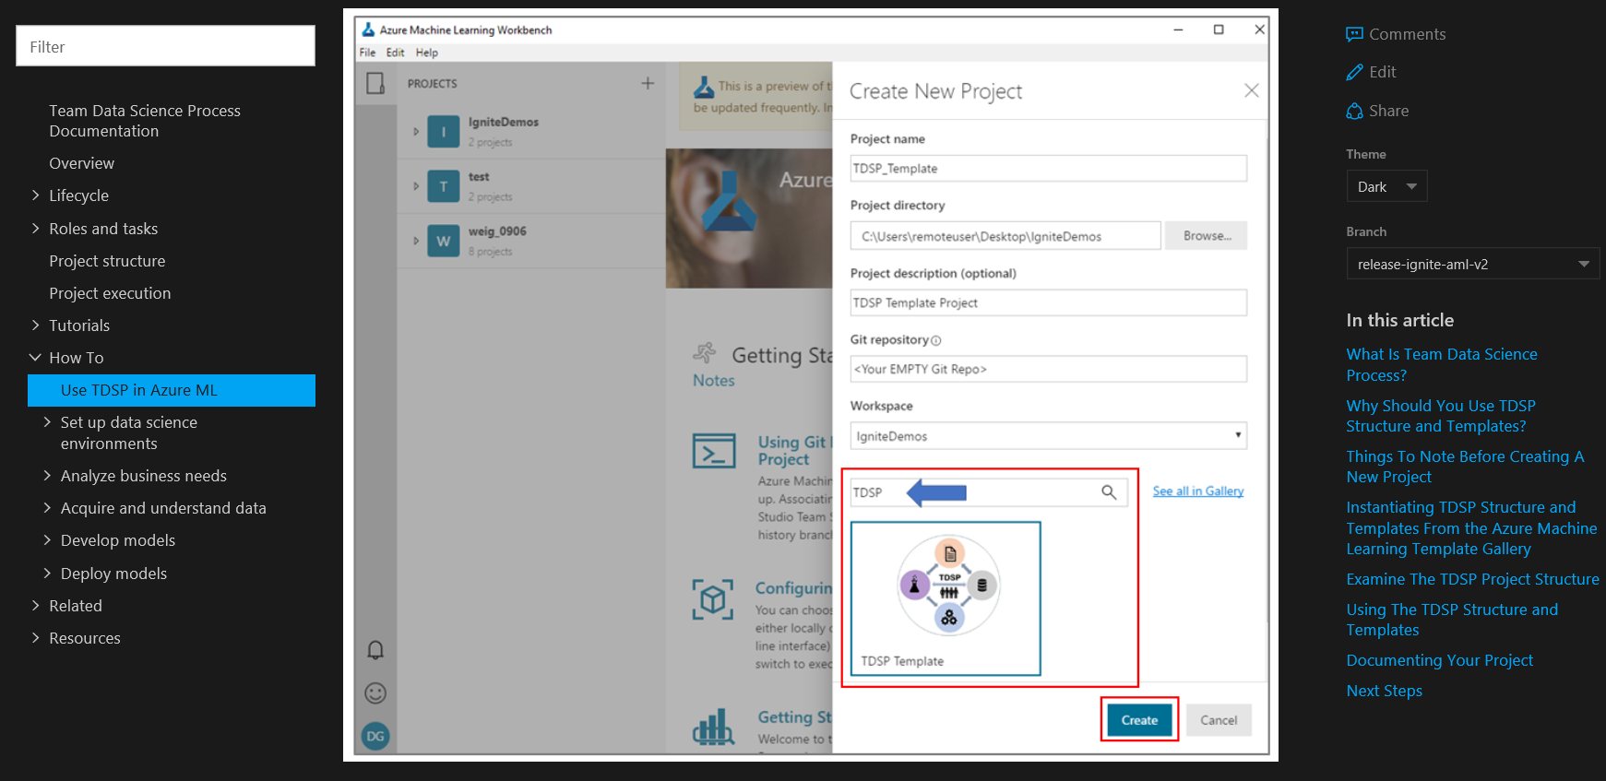
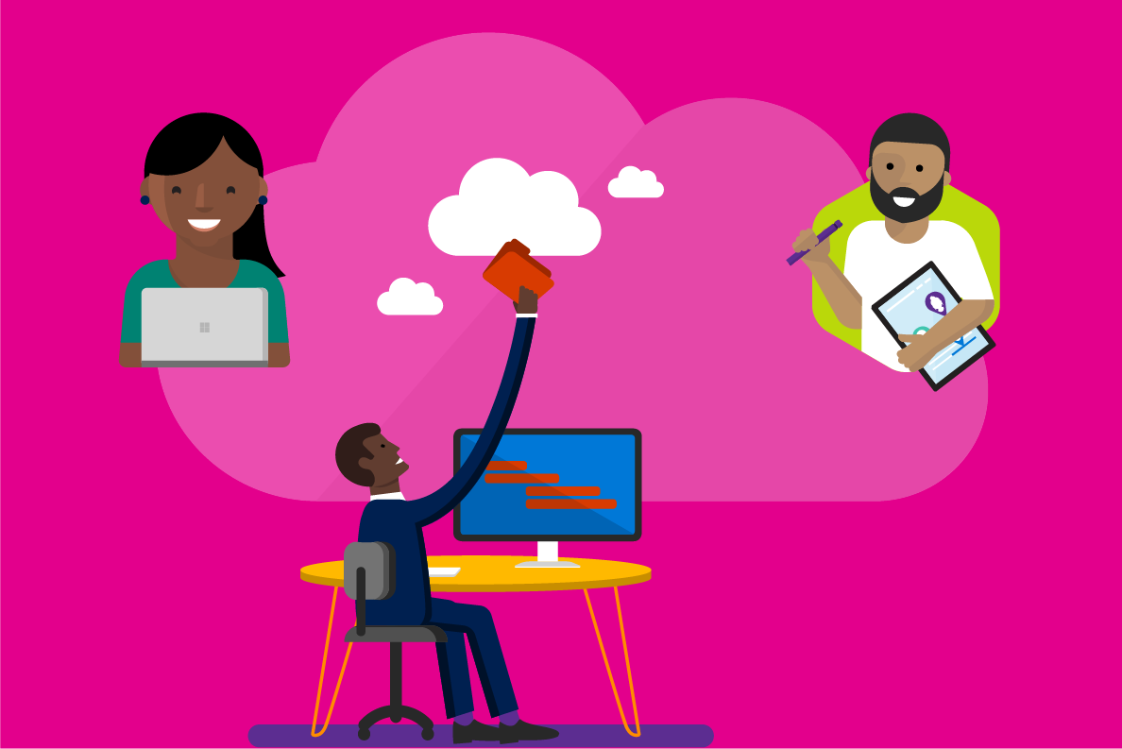
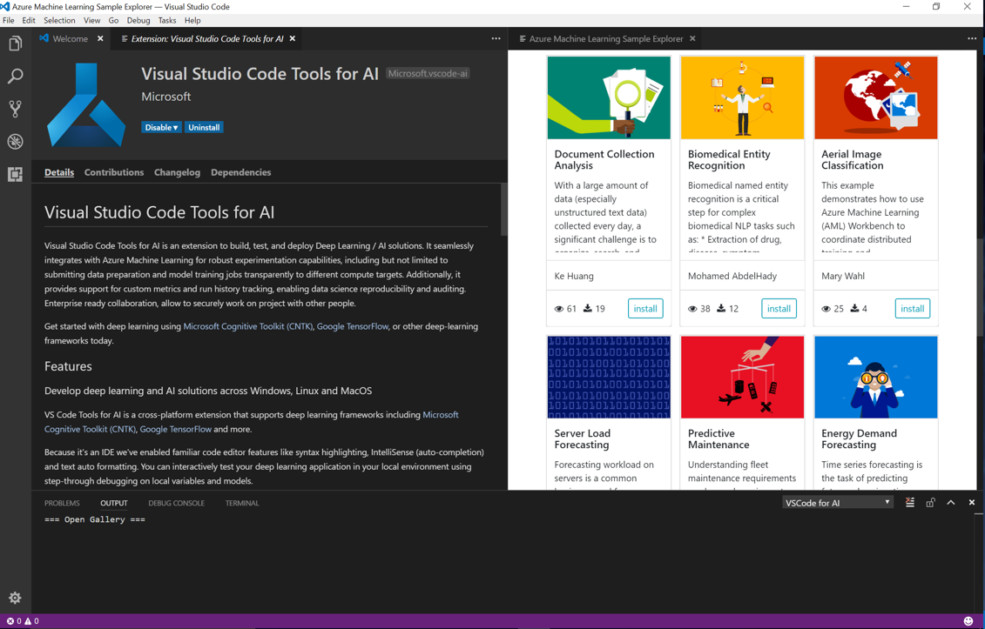
Using TDSP with Azure Machine Learning
28

Slide 29
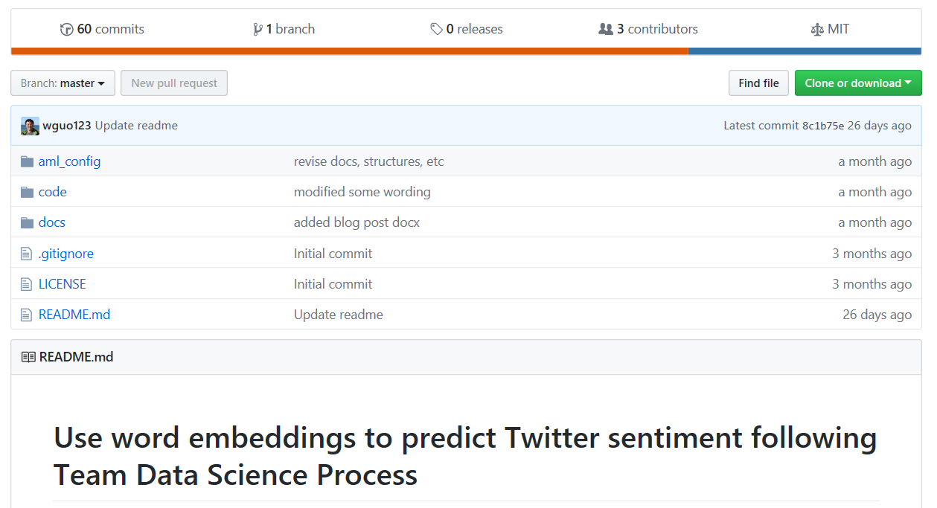
TDSP – AML worked-out samples in AI
29
Unstructured data (NLP) modeling with deep-learning
Sentiment classification using supervised word-embeddings
Biomedical (PubMed) Named entity recognition using LSTM
Structured data
Income classification
Public Github repositories for each sample
https://docs.microsoft.com/en-us/azure/machine-learning/team-data-science-process/walkthroughs

Slide 30
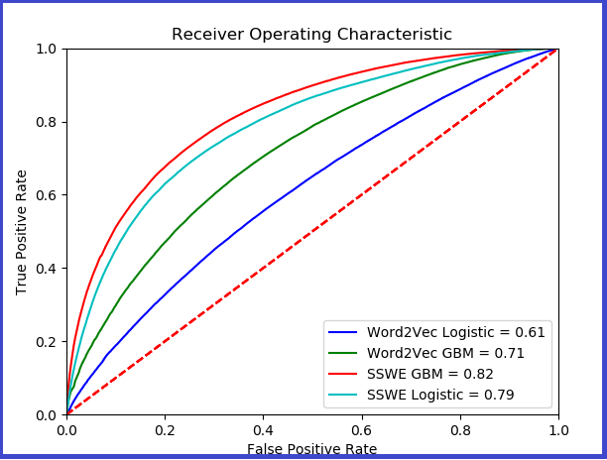
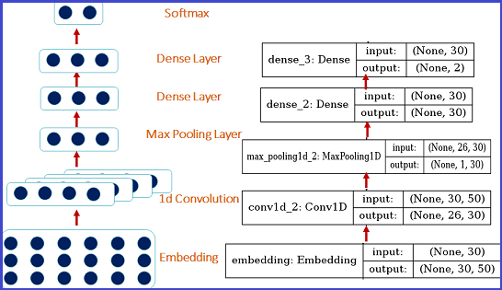
Sample: Sentiment-specific word embeddings (SSWE) improves classification of sentiments
CNN: Keras and CNTK
https://docs.microsoft.com/en-us/azure/machine-learning/team-data-science-process/predict-twitter-sentiment
http://www.aclweb.org/anthology/P14-1146

Slide 31
Summary
31
A well-defined data science process is critical to bridge the gap between opportunities and challenges, and put AI models in production to impact businesses
A combination of appropriate process (e.g. TDSP), tools (e.g. AML) and data-platforms (e.g. DSVM) is important for efficient development and deployment of AI solutions
TDSP – process
AML – tool
A process such as TDSP can be used with a variety of tools and data platforms
Resources are available to use TDSP and AML together, along with other data platforms on Azure to efficiently build and deploy AI solutions on the cloud

Slide 32
Thank you!
32
https://aka.ms/tdsp
tdsp-feedback@microsoft.com
Deck available @: https://aka.ms/tdsp-presentations

